Slide 1
Advent Appeal 2025
December 1st to December 31st

Slide 2

Advent with ADRA
Notes:
This season, we invite you to ADVENT with ADRA.
Join us to warm a heart and give a gift to those most vulnerable this season.
Even though the season is usually characterised by celebration and plenty – Sadly, for many its just not the same. In fact, it is the extreme opposite.

Slide 3
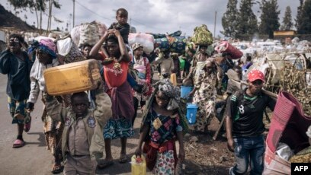
Current Situation Globally
123 million forcibly displaced people in the world – the highest in history!
Main Causes
Persecution
Conflict
Violence
Natural Disasters
Human Rights Violations
Notes:
As we approach the Advent season – a time of reflection, giving and hope, we ask you to partner with ADRA-UK, your charity – in bringing light to those who are facing unimaginable hardship.
For the Advent Appeal this year we are focusing on supporting families who have lost everything due to conflict, disaster and displacement.
According to the United Nations Human Rights Council (UNHRC), there are now 123 million people forcibly displaced across the world. This is the highest number in history!
One of the main cause is conflict and persecution. As we speak there are 110 armed conflict happening around the world. However not all of them are getting air time on the news so most people don’t know they are happening. We hear of some of them though – eg – Israel and Gaza, Ukraine and Russia, South Sudan, Venezuela and many more happening all over the world which result in people having to flee their homes with what they can carry on their backs.
Others are caused by natural disasters – this year alone ADRA has been helping to support 4 natural disasters. Some of the recent ones included Afghanistan Earthquake which shook the end of August, Myanmar Earthquake from earlier this year. The Philippines alone have been hit by 7 natural disasters in just a short 3 month period. Yes, they had 2 earthquakes and 5 typhoons. More recently, Hurricane Melissa (described as the ‘storm of the century’) devasted several islands across the Caribbean.
These natural disasters are increasing in frequency every year. They cause widespread devastation and suffering also. Leaving people without the basic necessities of life – food, water, shelter as well as health and overall well-being.
Families – including women and children are unable to live LIFE as we know it and can enjoy here in this country – Instead, they are left trying to SURVIVE on a daily basis.

Slide 4
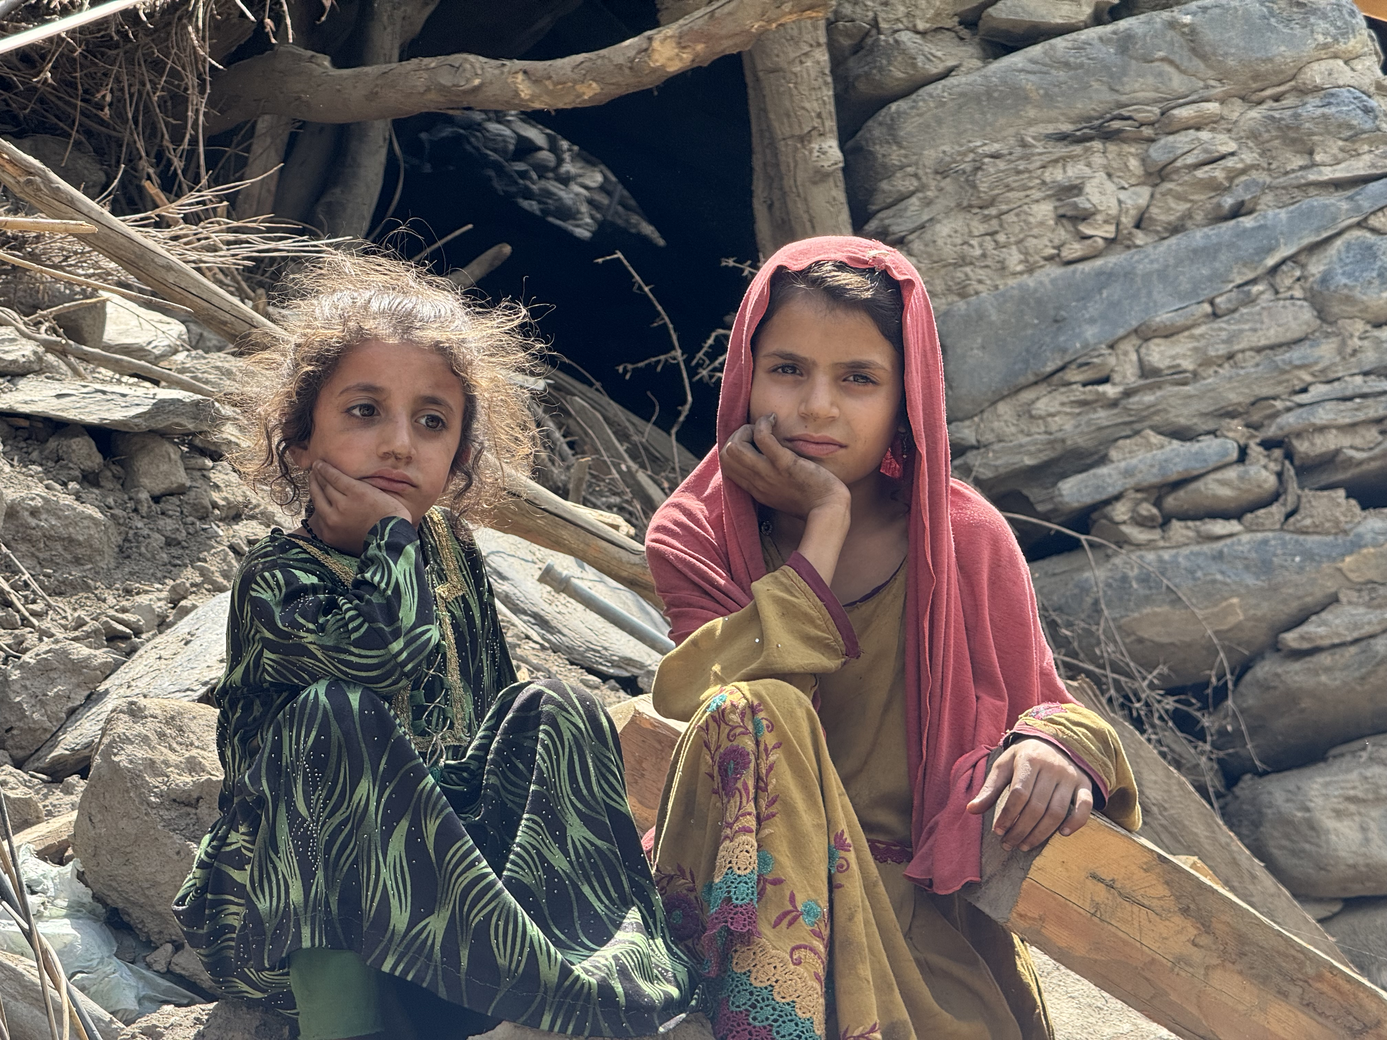
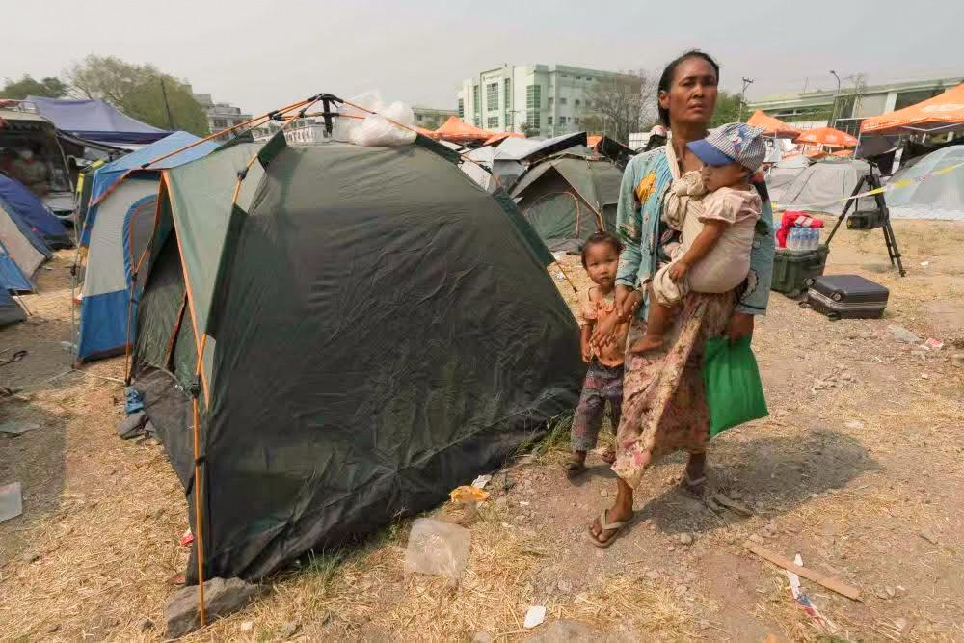
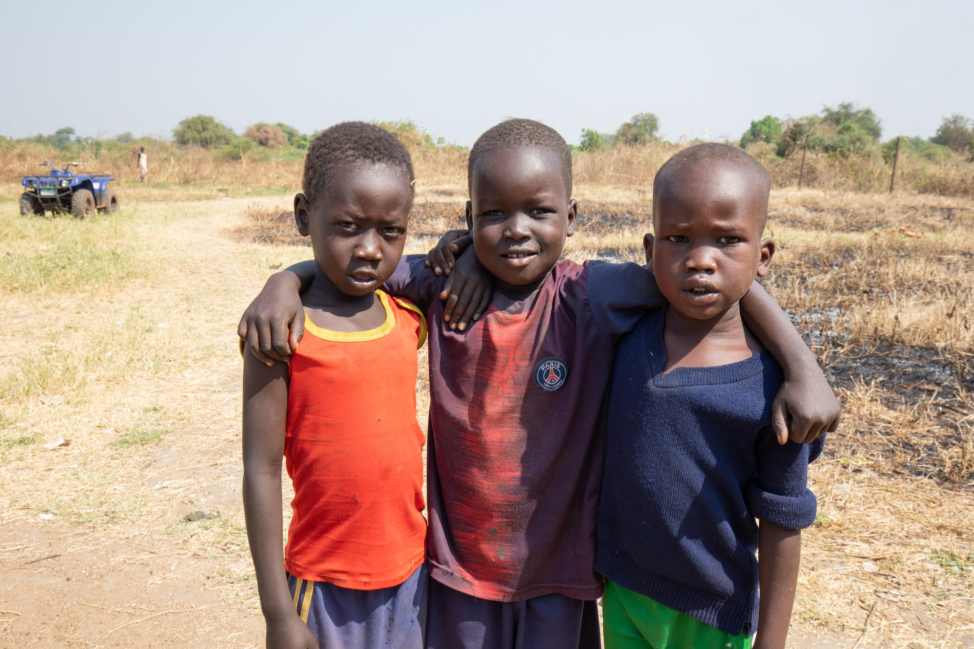
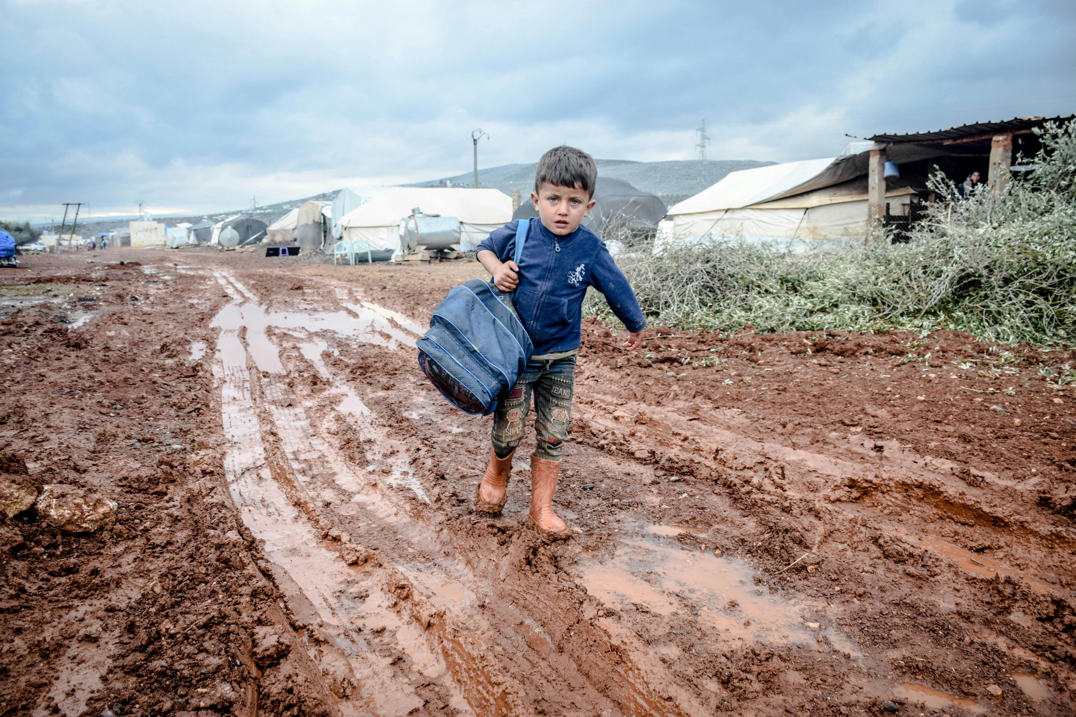
Displaced Families
Afghanistan children left homeless after devastating earthquake earlier this year.
A family at a makeshift camp site after the earthquake in Myanmar earlier this year.
Children in the Upper Nile region, Sudan.
Internal conflict caused many families to flee their homes and livelihoods.
A Syrian refugee child in winter
Notes:
These are actual photos of a few displaced children / families based on current issues in their respective countries.
Afghanistan children sit on a pile of rubble where their homes once stood. Earthquake destroyed their home in August this year.
A family left homeless at a makeshift shelter / camp in Myanmar after strong earthquake destroyed everything they once owned.
in Syria at the Refugee camp and in Sudan.
Children in Upper Nile, Sudan as internal conflict caused many families to flee their homes and livelihoods.

Slide 5
“What you did caring for the underprivileged was as pleasing to my Father as if you had done it for me.”
Matthew 25:40
“Do no wait to be told your duty. Open your eyes and see who are around you; make yourselves acquainted with the helpless, afflicted and needy. Hide not yourself from them and seek not to shut out their needs.”
Testimonies for the Church, vol 2. Pg 29
Notes:
Our Bible admonishes us to look out for those in need, time and time again as this is pleasing to our Heavenly Father.
Also, Sis White instructs us not to wait to be told our duty. Let’s read it together on the slide.

Slide 6
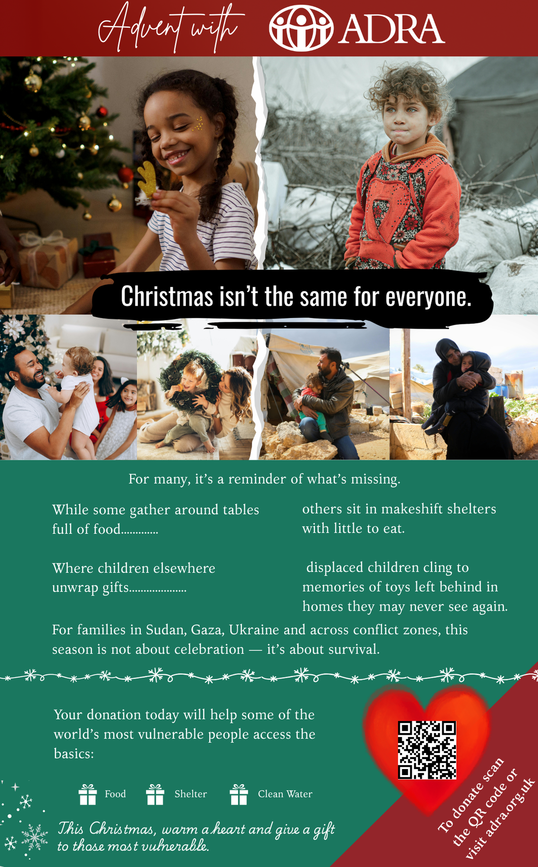






Please help someone in need this season…
Your donation can provide:
Food for the hungry
Clean Water for the thirsty
Shelter for families who have lost their homes
Hygiene Kits to protect health and dignity

Slide 7
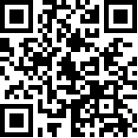
To Donate:
Scan the QR Code
Visit our website: www.adra.org.uk
More information on Advent Appeal: https://adra.org.uk/advent-appeal-2025/
Cash Donations – insert in an envelope and label it for – ‘ADRA Advent Appeal’
Cheques can be made out to: ADRA-UK and sent to us through the post to:
ADRA-UK, Stanborough Park, Watford, WD25 9JZ

Slide 8


We thank the Lord for each of you!
Thank you for supporting ADRA throughout the year and for the compassion you have shown through your prayers, donations and fundraising effort.

